Slide 1

Presented by: Ekaterina Nestoklon, Christoph Schneider & Naim Burrack
(July 25, 2025)

Slide 2
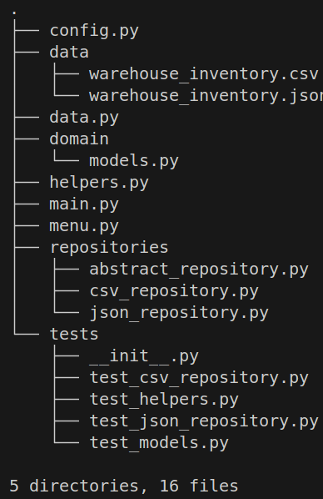
OOPSIE 2.0: What changed?
We removed: User-authentication & Versioning
We improved: Model-seperation, Modular design of repositories (CSV/JSON), Stable unit testing via Python’s unittest framework.

Slide 3
Modular Repository Design
Abstract base repositories for CSV and JSON backends.
Factory to select repository by dynamic file extension.
Swap storage without making changes outside config file.

Slide 4
Unit Testing Highlights
Tested core domain behaviours (add, remove, search, occupancy).
Tested repository read/write for CSV & JSON.
Used mocking for input/output helpers.
Tests ensure confidence in refactor and support future changes.

Slide 5
Summary:
We now have a simple, clean domain layer without conflicts.
Flexible storage backend with easy config changes.
Automation of tests, increased reliability & future feature implementation.
Foundation for scaling and better maintenance

Slide 6

Q&A / Next Steps
For the future: Implement richer domain entities, UI improvements, Continuous Integration (CI) pipeline improvements, reintegration of Versioning & User Authentication.
THANK YOU FOR LISTENING! If you have any questions, please ask us after the vacation ;)

